Slide 1
Pre-Entry Coalition
Community Connections Not Confinement

Slide 2
What is Pre-Entry?
Pre-Entry (noun):
a system of support services for people who have been arrested that does not rely on cash bail to achieve safety in the community or appearance in court.

Slide 3
Why Pre-Entry?

Slide 4
What’s at Stake?
Arrest
Lose Benefits
Lose Housing
Lose Kids
Lose Hope
Lose Job

Slide 5
What Do We Know When Deciding?

Slide 6
What More Should We Know?
Problem-Solving, Future Planning
Respect, Confidence, Achievement
Family, Community Connections
Employment, Healthcare, Stability
Housing, Food, Basic Needs

Slide 7
How Does This Work?
A client was charged with three felonies an Burglary, Criminal Trespassing, and Criminal Mischief and bail was set at $10,000.
He faced a maximum sentence of up to 27 and was likely to be sentenced for up to 10 years in prison.
SUPPORT & INTERVENTION
Upon meeting him in jail to prepare for his Early Bail Review hearing, his Bail Advocate learned he was homeless and struggling with a drug addiction.
The Bail Advocate worked swiftly to enroll him in inpatient treatment and then to help him transition into a recovery house.
OUTCOMES
The Advocate communicated his needs and the community solutions to the defense attorney who used it to negotiate with the prosecutor.
The client was convicted of a misdemeanor, avoiding the felony conviction as well as jail and probation.
Had the treatment program not accepted the referral on such short notice, the client would have been more likely to plea to a more serious charge in order to leave jail.
BACKGROUND

Slide 8
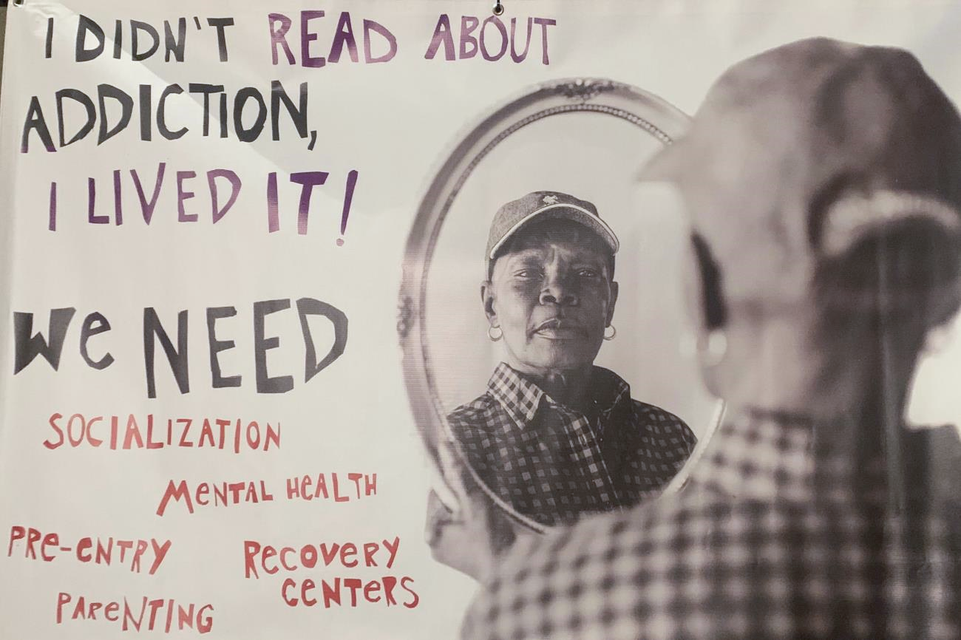
How Can You Help?

Slide 9
